Slide 1
Statistical Analysis
Lesson 1

Slide 2
What is Statistical Analysis
It’s the science of collecting, exploring and presenting large amounts of data to discover underlying patterns and trends. Statistics are applied every day – in research, industry and government – to become more scientific about decisions that need to be made.

Slide 3
Who uses these Analytics
Manufacturers use statistics to weave quality into beautiful fabrics, to bring lift to the airline industry and to help guitarists make beautiful music.
Researchers keep children healthy by using statistics to analyze data from the production of viral vaccines, which ensures consistency and safety.
Communication companies use statistics to optimize network resources, improve service and reduce customer churn by gaining greater insight into subscriber requirements.
Government agencies around the world rely on statistics for a clear understanding of their countries, their businesses and their people.

Slide 4
How to derive it from our research
Describe the nature of the data to be analyzed.
Explore the relation of the data to the underlying population.
Create a model to summarize understanding of how the data relates to the underlying population.
Prove (or disprove) the validity of the model.
Employ predictive analytics to run scenarios that will help guide future actions.

Slide 5
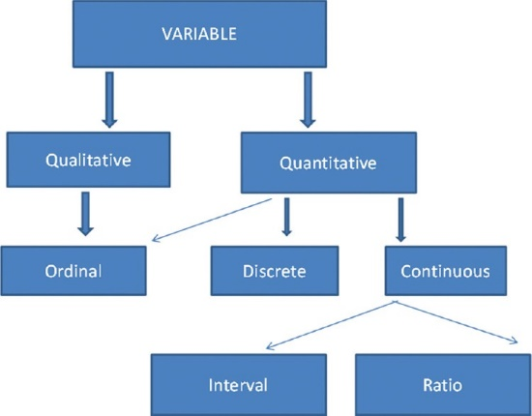

Slide 6
Different types of Statistical Analysis
Descriptive Type of Statistical Analysis
Inferential Type of Statistical Analysis
Prescriptive Analysis
Predictive Analysis
Casual Analysis
Exploratory data analysis
Mechanistic Analysis

Slide 7
Methods & Pitfalls

Slide 8
1. Mean
The arithmetic mean, more commonly known as “the average,” is the sum of a list of numbers divided by the number of items on the list. The mean is useful in determining the overall trend of a data set or providing a rapid snapshot of your data. Another advantage of the mean is that it’s very easy and quick to calculate.
Pitfall:
Taken alone, the mean is a dangerous tool. In some data sets, the mean is also closely related to the mode and the median (two other measurements near the average). However, in a data set with a high number of outliers or a skewed distribution, the mean simply doesn’t provide the accuracy you need for a nuanced decision.

Slide 9
2. Standard Deviation
The standard deviation, often represented with the Greek letter sigma, is the measure of a spread of data around the mean. A high standard deviation signifies that data is spread more widely from the mean, where a low standard deviation signals that more data align with the mean. In a portfolio of data analysis methods, the standard deviation is useful for quickly determining dispersion of data points.
Pitfall:
Just like the mean, the standard deviation is deceptive if taken alone. For example, if the data have a very strange pattern such as a non-normal curve or a large amount of outliers, then the standard deviation won’t give you all the information you need.

Slide 10
3. Regression
Regression models the relationships between dependent and explanatory variables, which are usually charted on a scatterplot. The regression line also designates whether those relationships are strong or weak. Regression is commonly taught in high school or college statistics courses with applications for science or business in determining trends over time.
Pitfall:
Regression is not very nuanced. Sometimes, the outliers on a scatterplot (and the reasons for them) matter significantly. For example, an outlying data point may represent the input from your most critical supplier or your highest selling product. The nature of a regression line, however, tempts you to ignore these outliers. As an illustration, examine a picture of ANSCOMBE’S QUARTET, in which the data sets have the exact same regression line but include widely different data points.

Slide 11
4. Sample Size Determination
When measuring a large data set or population, like a workforce, you don’t always need to collect information from every member of that population – a sample does the job just as well. The trick is to determine the right size for a sample to be accurate. Using proportion and standard deviation methods, you are able to accurately determine the right sample size you need to make your data collection statistically significant.
Pitfall:
When studying a new, untested variable in a population, your proportion equations might need to rely on certain assumptions. However, these assumptions might be completely inaccurate. This error is then passed along to your sample size determination and then onto the rest of your statistical data analysis

Slide 12
5. Hypothesis Testing
Also commonly called t testing, hypothesis testing assesses if a certain premise is actually true for your data set or population. In data analysis and statistics, you consider the result of a hypothesis test statistically significant if the results couldn’t have happened by random chance. Hypothesis tests are used in everything from science and research to business and economic
Pitfall:
To be rigorous, hypothesis tests need to watch out for common errors. For example, the placebo effect occurs when participants falsely expect a certain result and then perceive (or actually attain) that result. Another common error is the Hawthorne effect (or observer effect), which happens when participants skew results because they know they are being studied.

Slide 13
Overall, these methods of DATA ANALYSIS add a lot of insight to your DECISION-MAKING PORTFOLIO, particularly if you’ve never analyzed a process or data set with statistics before. However, avoiding the common pitfalls associated with each method is just as important. Once you master these fundamental techniques for statistical data analysis, then you’re ready to advance to more powerful data analysis tools.

Slide 14
Statistics in EXCEL
Before starting, you need to check whether Excel Analysis ToolPak is enabled in Excel or not (it is an add-in provided by Microsoft Excel). To check whether it is enabled or not, go to Excel → Data and check whether data analysis option is there or not on the top right corner. If it is not there, go to Excel → File → Options → Add-in and enable the Analysis ToolPak by selecting the Excel Add-ins option in manage tab and then, click GO. This will open a small window; select the Analysis ToolPak option and enable it.

Slide 15
What we shall be focusing on in Practical's
1 Sort: You can sort your Excel data on one column or multiple columns. You can sort in ascending or descending order.
2 Filter: Filter your Excel data if you only want to display records that meet certain criteria.
3 Conditional Formatting: Conditional formatting in Excel enables you to highlight cells with a certain color, depending on the cell's value.
4 Charts: A simple Excel chart can say more than a sheet full of numbers. As you'll see, creating charts is very easy.

Slide 16
Continued …
5 Pivot Tables: Pivot tables are one of Excel's most powerful features. A pivot table allows you to extract the significance from a large, detailed data set.
6 Tables: Tables allow you to analyze your data in Excel quickly and easily.
7 What-If Analysis: What-If Analysis in Excel allows you to try out different values (scenarios) for formulas.
8 Solver: Excel includes a tool called solver that uses techniques from the operations research to find optimal solutions for all kind of decision problems.
9 Analysis ToolPak: The Analysis ToolPak is an Excel add-in program that provides data analysis tools for financial, statistical and engineering data analysis.

